Slide 1
TEMPERATURE &
CORONAVIRUS
Is there evidence for a significantly negative association between temperature and the spread of COVID-19 in the US in 2020?
Camille COSANDIER, Pascal SCHOCH and Eduardo PACHECO
MSc in Applied Information and Data Science, Hochschule Luzern
April 13th, 2022

Slide 2
Introduction
Our objective is to identify the relationship between COVID-19 and temperature.
History of Respiratory Viruses
Evolution of Regulations
Evolution of
COVID-19 Cases
Respiratory viruses usually follow a seasonal pattern and tend to have a higher incidence during winter.
Government's measures seemed to follow a seasonal pattern as well and to be less strict during the hot seasons.
We can observe an increase of positive cases in the United States during Winter 2020 and 2021

Slide 3
Key questions & Main Findings
Is there evidence for a significantly negative association between
temperature and the spread of COVID-19 in the US in 2020?
1
Is there any correlation between the COVID-19 and the temperature?
MAIN FINDINGS
Decreasing in the daily mean temperature had indeed a negative effect on the rate of COVID-19 infections.
Based on our final PLM the demographic predictors have as well a significant effect on the number of new infections.
Due to the large differences in county sizes, it would not have make sense to analyze the discrepancies.
1
2
What is the influence of the control variables?
2
3
3
Is there any discrepancies between counties?

Slide 4
COVID-19 Recommendations
We used various datasets to be able to solve our research question.
Temperature
Data
Covid
Cases
Population Density
& Housing units
City County
Mapping Table
Temperature and precipitation data for 210 cities in separate CSV files
Format: timeseries, daily
Granularity: cities latitudes & longitudes
One additional CSV file with the names of cities, stations and of their respective Geo-Coordinates
Covid cases
Format: panel data, daily
Granularity: cities latitudes & longitudes
Population density
Format: for one year
Granularity: per county
Housing units
Format: yearly
Granularity: per county
Cities
Counties
States
Geo-Coordinates
Notes:
210 Temperature stations in separate CSV Files
Format: Timeseries, daily
Granularity: Cities Lat. & Long.
One CSV File with all geo coordinates and names of temperature stations
Covid Cases
Panel Data, daily
Granularity: Cities Lat & Long
Total Housing Units
Format: Value per County per year
Population Units
Granularity: per County
Cities
Counties
States
Geocoordinates

Slide 5
Data cleansing and data preparation
We combined various data sources in order to create a unique finale dataset.
Names
IDs
Lat.
Long.
All temperature stations in time series format
Final merged Dataset
to analyze
210
Min. & max. temperatures
per station and precipitation
210
temperature_data/
USC00042863
USC00166584
…
temperature_data/city_info.csv
temperature_long.csv
covid_temp_density_housing_without_parish_city.csv
Cities, latitudes. & longitudes
Counties
Counties, cases and deaths
Population density and number of housing units
Geo-Coordinates Mapping
Covid Cases
Population & Housing
Find closest cities to counties
Calculate distance:
Max: 18.4 km
Mean: 5.8 km
Counties
geomapping.csv
us_counties_covid19_daily.csv
Average_Household_Size_and_Population_Density_-_County-2018.csv
ACSDP5Y2020.DP05_data_with_overlays_2022-03-18T082305.csv
Cities, counties, latitudes. & longitudes
City county mapping table
us_cities_mapping.csv

Slide 6
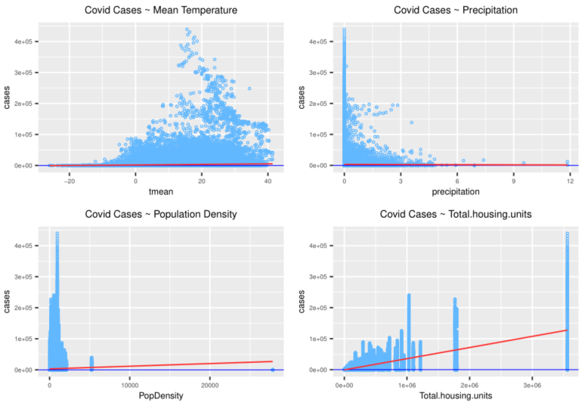
Visualizing and Understanding the Data
We produced a simple linear regression plot for each predictor:
Climate Variables
Slight positive relationship between cases and mean temperature.
Precipitation seems to have no influence on the target variable.
Demographics Variables
Both population density and total housing units seem to have a significant positive relationship.

Slide 7
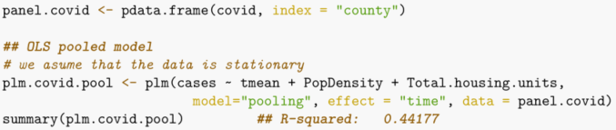
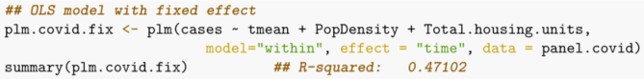
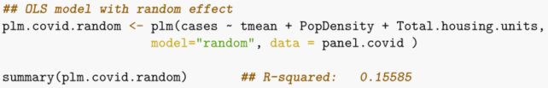
Panel Data Analysis with Ordinary Least Squares Regression (OLS)
Panel data modelling is a method to estimate data which is both time series and cross-sectional.
Pooled Modeling
Assumes the data to be stationary, the intercept and slope for each entity (county) have constant coefficients. Allowing the “pooling” of all the data to run a OLS regression model.
Fixed-Effect Modeling
Focuses in the interaction of the observations “within” the same entity (county), by comparing variations at different periods of time.
Random-Effect Modeling
Assumes that the values of an independent variable are drawn at “random” from a larger population of possibilities. The intercept follows a random normal distribution for each entity.

Slide 8
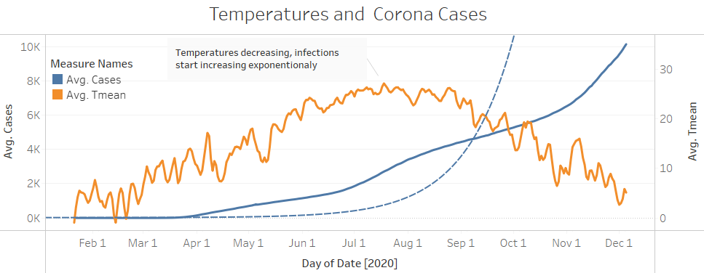
The winner “Fixed-Effect Model”
Testing poolability of fixed-effect, and consistency between fixed-effect and random-effect models.
Poolability test
Fixed-Effect Model Results
Test design to proof poolability of fixed-effect model.
Ho: The same coefficients apply to each entity (stable)
Ha: Same coefficients do not apply to each entity. (unstable)
Hausman test
Test design to compare fixed and random-effect models.
Ho: Random-effect model is consistent.
Ha: Fixed-effect model is consistent.

Slide 9
Limitations, Areas of Improvement
More time and some statistical advanced knowledge would have benefit our analysis.
Data Granularity
Unbalanced Panel Dataset
Agreeing on the right level of detail and finding the corresponding datasets was challenging.
Our final dataset did not allow us to fit some other OLS models.
Remaining Bias
Lack of Statistical Knowledge
Using a mixed effect model and enriching our dataset would have benefit our analysis. However, some predictors remain out of reach.
Ideally, we would have to venture into the “Principles of Econometrics”.
Notes:
Data granularity: the temperature of one weather station are taken to analyze a whole county.
In order to properly analyze panel data with the use of Ordinary Least Square (OLS) regression, it is very useful to have a balanced data frame.
Our final model contains indeed some bias, as we are assuming that all the effects that we are studying are fixed. But there are potential random effects all over the place and ideally we would have spot them and deal with them. However, using the OLS methods allowed us to minimize the random effect by utilizing the differences in the average values of each county (Fixed effect). But this is throwing away a lot of data. even though we think that a better alternative would be to run a mixed effect model.
Another potential random effect to consider lays in the fact, that the recording of the temperatures are coming from different weather stations all over the country, most likely each station operates with different hardware and technologies. Which adds another set of bias coming from the variation in accuracy and precision, in the measures provided by each weather station.
The lack of advance statistical knowledge is a limitation to be consider in the assessment of our study. We would have to venture beyond the simple statistical test which are taught in some basic stats courses, and dive into the “Principles of Econometrics” . In particular we would have to take a look into “Mixed Effect Models”, which allows to model a mixture of fixed and random effects.

Slide 10
Conclusion
There is evidence for a significantly negative association between temperature and the spread of COVID-19, in the US, in 2020.
1
2
3
Methodology
Response variable
Control variables
The implementation of an iterative analysis on PLMs allowed us to select the model with the higher performance.
The temperature had indeed a negative effect on the rate of COVID-19 infections.
Based on our final PLM, the demographic predictors have a significant effect on the number of new infections as well.
Notes:
The main purpose of our study was to test the effect of temperature on the dependent variable,
Trough an iterative approach to analyze PLMs, we were able to compare their performance, with different testing tools, for example the Hausman test which allowed us to select the model that would fit our data the best.
We found out that temperature had indeed a negative effect on the rate of COVID-19 infections.
Based on our final PLM the demographic predictors have as well a significant effect on the number of new infections.
with this approach is very likely that we are looking at a fixed effect. For this reason, the OLS model that we have chosen fits the data in a really good way .
But as we have added other predictor to make our model more robust, we had also added some potential random effects which have biased our analysis in certain way.
Omitted-variable bias (OVB) occurs when a statistical model leaves out one or more relevant variables, attributing the effect of the missing variables to those that were included. This results in adding more bias to the model. For example, health care and economic factors may have had a significant influence in the corona infections, which were not taken in consideration in our study.
Nevertheless considering the time restrictions, we are happy to confirm our initial assumption of the temperature having a significant effect in the number of corona infections.
1st linear model
2nd with the interactions
3rd Anova test
4th PLM

Slide 11
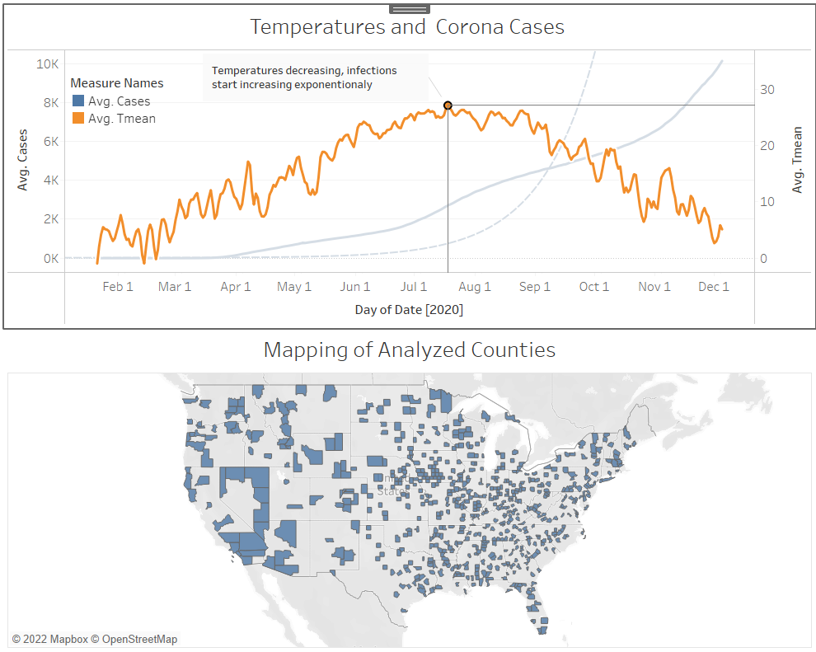
Appendix

Slide 12
Reference Table
AUDI, Amani, ALIBRAHIM, Malak, KADDOURA, Malak, HIJAZI, Ghina, YASSINE, Hadi M. and ZARAKET, Hassan, 2020. Seasonality of Respiratory Viral Infections: Will COVID-19 Follow Suit? Frontiers in Public Health. Online. 2020. Vol. 8. [Accessed 9 April 2022]. Retrieved from: https://www.frontiersin.org/article/10.3389/fpubh.2020.567184
BIRBAUMER, Mirko and BÜCHEL, Peter 2021. Lecture Notes: Statistics [online]. 16 December 2021. [Accessed 10 March 2022]. Retrieved from: https://elearning.hslu.ch/ilias/ilias.php?ref_id=5074778&cmd=view&cmdClass=ilrepositorygui&cmdNode=10f&baseClass=ilrepositorygui
COLONESCU, Constantin, 2016. Principles of Econometrics with R. Online. [Accessed 9 April 2022]. Retrieved from: https://bookdown.org/ccolonescu/RPoE4/
CROISSANT, Yves and MILLO, Giovanni, 2022a. Package ‘plm.’ Online. [Accessed 9 April 2022]. Retrieved from: https://cran.r-project.org/web/packages/plm/plm.pdf
CROISSANT, Yves and MILLO, Giovanni, 2022b. Data structure. Online. [Accessed 9 April 2022]. Retrieved from: https://cran.r-project.org/web/packages/plm/vignettes/A_plmPackage.html
DATA SCIENCE PROJECT MANAGEMENT, 2022. CRISP-DM. Data Science Process Alliance. Online. 2022. [Accessed 8 March 2022]. Retrieved from: https://www.datascience-pm.com/crisp-dm-2/
DATACAMP, 2022. plm function - RDocumentation. Online. 2022. [Accessed 9 April 2022]. Retrieved from: https://www.rdocumentation.org/packages/plm/versions/2.6-1/topics/plm
FOPH, Federal Office of Public Health, 2021. Coronavirus : le quatrième assouplissement qui commence lundi sera plus important que prévu. Online. 2021. [Accessed 10 April 2022]. Retrieved from: https://www.admin.ch/gov/fr/accueil/documentation/communiques.msg-id-83697.html
FOPH, Federal Office of Public Health, 2022. Coronavirus: le Conseil fédéral lève les mesures – l’obligation de porter un masque dans les transports publics et les établissements de santé ainsi que l’isolement sont maintenus jusqu’à fin mars. Online. 2022. [Accessed 10 April 2022]. Retrieved from: https://www.admin.ch/gov/fr/accueil/documentation/communiques.msg-id-87216.html
HEALTHDATA, 2022. COVID-19 Diagnostic Laboratory Testing (PCR Testing) Time Series | HealthData.gov. Online. 9 March 2022. [Accessed 7 March 2022]. Retrieved from: https://healthdata.gov/dataset/COVID-19-Diagnostic-Laboratory-Testing-PCR-Testing/j8mb-icvb
LAI, Yuchan and DZOMBAK, David, 2019. Compiled historical daily temperature and precipitation data for selected 210 U.S. cities. Online. 5 April 2019. [Accessed 8 March 2022]. DOI 10.1184/R1/7890488.v5. Type: dataset
MORIYAMA, Miyu, HUGENTOBLER, Walter J. and IWASAKI, Akiko, 2020. Seasonality of Respiratory Viral Infections. Annual Review of Virology. 29 September 2020. Vol. 7, no. 1, pp. 83–101. DOI 10.1146/annurev-virology-012420-022445.
NATIONAL COVID-19 SCIENCE TASK FORCE (NCS-TF), 2020. The importance of seasonality and climate on the risk of COVID-19: rapid review Online. [Accessed 7 March 2022]. Retrieved from: https://sciencetaskforce.ch/wp-content/uploads/2020/10/Importance-of-seasonality-and-climate-on-the-risk-of-COVID-19-26-May-20-EN.pdf
NOTTINGHAM, University of, 2019. Fixed and random effects with Tom Reader. Online. 2019. [Accessed 9 April 2022]. Retrieved from: https://www.youtube.com/watch?v=FCcVPsq8VcA
OFSP, Office fédéral de la santé publique, 2020. Ouverture des frontières au 15 juin 2020. Online. 2020. [Accessed 10 April 2022]. Retrieved from: https://www.bag.admin.ch/bag/fr/home/das-bag/aktuell/news/news-15-06-2020.html
PHILLIPS, Nathaniel D., 2022. YaRrr! The Pirate’s Guide to R. Online. [Accessed 9 April 2022]. Retrieved from: https://bookdown.org/ndphillips/YaRrr/
SIMPLEMAPS, 2021. US Cities Database | Simplemaps.com. Online. 2021. [Accessed 6 March 2022]. Retrieved from: https://simplemaps.com/data/us-cities
THE NEW YORK TIMES, 2022. Coronavirus in the U.S: Latest Map and Case Count. Online. 10 March 2022. [Accessed 6 March 2022]. Retrieved from: https://www.nytimes.com/interactive/2021/us/covid-cases.html
UNITED STATES CENSUS BUREAU, 2021. Index of /programs-surveys/popest/datasets/2020-2021/state/totals. Online. 2021. [Accessed 7 March 2022]. Retrieved from: https://www2.census.gov/programs-surveys/popest/datasets/2020-2021/state/totals/
VARIOUS AUTHORS, 2022. Omitted-variable bias. Wikipedia. Online. [Accessed 9 April 2022]. Retrieved from: https://en.wikipedia.org/w/index.php?title=Omitted-variable_bias&oldid=1066538235 Page Version ID: 1066538235

Slide 13
THANK YOU

Slide 14
To Delete later -> MAX 10 SLIDES (without Appendix but including the title page)
Title - Camille
Motivational Introduction (+ relevance of our work for the domain?) - Camille
Key questions + Main Findings - Camille
Presentation of Datasets + Data cleansing and data preparation (flowchart?) (½) - Pascal
Data Cleansing (2/2) - Pascal
Conducting Analysis - Eduardo
Conducting Analysis (Charts/visuals) - Eduardo
Limitations and areas of improvement + Conclusion? (+Thanks?) - Camille
Appendix
Reference table
-> Start the slides and we will conduct a brainstorming in the week to complete the slides together

Slide 15
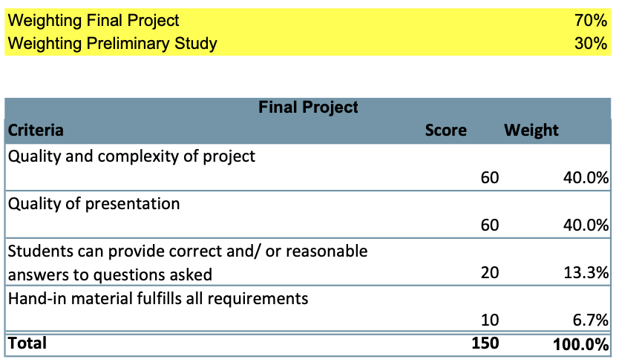
Guidelines
1. Introduction
As a Data Scientist you will find yourself regularly in situations in which you will be asked to present your analysis and your findings to an audience, possibly a managerial audience. In my experience, being able to present well is a skill that is repeatedly underestimated in importance. As a Data Scientist it is therefore critical that you are able to present your content in a well-structured, convincing, and attractive way. This document gathers mandatory and recommended guidelines for your presentations in our module "Data Science in Health Care".
2. Mandatory Guidelines - Please be on time. Delay is not acceptable. - Please be prepared. In particular, be sure to test your presentation in advance. You will not receive time to fix things that do not work when you should start presenting. I strongly recommend that you test your presentation in exactly the same setting in which the final exam will take place. - Do not use PowerPoint. Instead, rely on PDF-files. Even nowadays PowerPoint-documents may cause problems on computers different from the one on which the files were created. - Prepare fallback-options. For example, be sure that you have backed-up your files and that all your team-members are able to start the presentation (no single point of failure). - In a remote setting: Always activate your camera and mute your microphone if you are not speaking. - Label all your figures. All axes must have titles and units of measurement. - Use a reference table. Unless you properly indicate references, you are not allowed to use content of which you are not the owner. - All your slides (except for the title page) must have the slide number as well as the total number of slides indicated.
3.Recommended Guidelines
- Use a motivating introduction. The first seconds of your presentation are of utmost importance to gain the attention of your audience. - Introduce the subject of your presentation clearly. You must assume that your audience has no idea what you are going to talk about. Therefore, it is your task to clarify this at the beginning of your presentation. - Highlight the key questions which you investigated followed by your main findings at the start of your presentation. This allows your audience to get mentally prepared for what follows. - Highlight the relevance of your work for the domain in which you have conducted your work. For example, if you investigated on the determinants of diabetes mellitus highlight why it is important to better understand these determinants. - Do not overcharge your slides. Use text carefully and put supplementary documentation in the appendix. You will lose your audience if they become busy reading your slides during your presentation. - Formulate key-messages for all your slides in the header of each slide (usually one sentence). Key messages allow your audience to grasp the most important content in a few seconds. - Guide your audience: Use a pointer or mouse to navigate through the slides and highlight key points on the slides.
To Delete later - GUIDELINES
Slides
Your work should be consistent with your preliminary study (deviations possible but you should explain why)
You must hand in at least your presentation and your code used for the project
Presentation must be a PDF-file (no PPT)
Hand-in must be a single ZIP-file (only one file per group)
Hand-in is only accepted via Ilias (deadline published on Ilias)
Goal: High-quality presentation targeted towards a scientific management audience
Conditions:
- 10 min. for presentation
+ 5 min. to answer questions
At most 10 slides (without Appendix but including the title page)
Presentations take place remotely via Zoom in our ordinary classroom published on Ilias on April 8th, 23:55
There will be a second examiner present that day
To assess how much experience you gained, I will evaluate (a) your code, (b) the diversity, quality, and complexity of your data processing and analysis, and (c) your answers to questions during the presentation
13 questions we can expect : https://gradcoach.com/dissertation-thesis-defence/

Slide 16
Write Your Title
Confirmed
476,818
They are typically fair in their analysis of different brands and products and very often, their audiences trust their content. Your brand can leverage this by collaborating with influencers.

Slide 17
Write Your Title
Recovered
26,541
They are typically fair in their analysis of different brands and products and very often, their audiences trust their content. Your brand can leverage this by collaborating with influencers.

Slide 18
Write Your Title
Deaths
17,842
They are typically fair in their analysis of different brands and products and very often, their audiences trust their content. Your brand can leverage this by collaborating with influencers.

Slide 19
Total Coronavirus Cases in the US
40%
35%
Write Your Title
30%
There are people who have a significant number of followers in every business domain on social media these influencers.
25%
20%
15%
Write Your Title
10%
There are people who have a significant number of followers in every business domain on social media these influencers.
5%
0%
Apr
May
Jun
Jul

Slide 20
USA
State
Total
Cases
New
Cases
Total
Deaths
New York
170,000
9,000
7,844
New York
54,000
3,000
1,978
Pennsylvania
19,979
1,500
416
Louisiana
19,253
970
755

Slide 21
Know How It Spreads
1
2
3
Wash your
hands
Use a hand
sanitizer
Avoid touching your face
The disease causes respiratory illness with symptoms such as a cough, fever.
The disease causes respiratory illness with symptoms such as a cough, fever.
The disease causes respiratory illness with symptoms such as a cough, fever.

Slide 22
Know How It Spreads
1
The disease causes respiratory illness with symptoms such as a cough, fever, and in more severe cases, difficulty breathing.
The disease causes respiratory illness with symptoms such as a cough, fever, and in more severe cases, difficulty breathing.
1
The disease causes respiratory illness with symptoms such as a cough, fever, and in more severe cases, difficulty breathing.
The disease causes respiratory illness with symptoms such as a cough, fever, and in more severe cases, difficulty breathing.
3
Use a hand
sanitizer
2
4
The disease causes respiratory illness with symptoms such as a cough, fever.

Slide 23
Avoid Close Contact
COVID-19 is an infectious disease caused by a new virus
r
o
v
e
“
l
v
es
There are people who have a significant number of followers in every business domain on social media these influencers.
There are people who have a significant number of followers in every business domain on social media these influencers.

Slide 24
Take Steps to Protect Yourself
1
2
3
Your Title
Your Title
Your Title
Most businesses already know that social media platforms play an important role in online marketing.
Most businesses already know that social media platforms play an important role in online marketing.
Most businesses already know that social media platforms play an important role in online marketing.

Slide 25
Worldwide Map
62
60
58
56
54
52
50
48
46
44
1
2
There are people who have a significant number of followers in every business domain on social media these influencers.

Slide 26
01
SECTION
BREAK
There are people who have a significant number of followers in every business.

Slide 27
Symptoms
1
2
3
Fever
Sore Throat
Dry Cough
Most businesses already know that social media platforms play an important role in online marketing.
Most businesses already know that social media platforms play an important role in online marketing.
Most businesses already know that social media platforms play an important role in online marketing.

Slide 28

Image With Text
They are typically fair in their analysis of different brands and products and very often, their audiences trust their content. Your brand can leverage this by collaborating with influencers.

Slide 29


Image Gallery
There are people who have a significant number
There are people who have a significant number of followers in every business domain on social media these influencers.

Slide 30
Pie Charts Example
Write Something Here
Most businesses already know that social media platforms play an important role in online marketing.
Your Title
1
Most businesses already know that social media platforms play an important role in online marketing.
Your Title
2
+7290
Most businesses already know that social media platforms play an important role in online marketing.
Your Title
3
Most businesses already know that social media platforms play an important role in online marketing.
Business
Suppliers
Commuity

Slide 31
Bar Charts Example
Apr
20
1
The disease causes respiratory illness with symptoms such as a cough, fever, and in more severe.
May
40
The disease causes respiratory illness with symptoms such as a cough, fever, and in more severe.
Jun
80
2
Jul
40
3
The disease causes respiratory illness with symptoms such as a cough, fever, and in more severe.
Ago
50
Sep
55

Slide 32
02
SECTION
BREAK
There are people who have a significant number of followers in every business.

Slide 33
Keep Distance
2 M
Write Something Here
They are typically fair in their analysis of different brands and products and very often, their audiences trust their content. Your brand can leverage this by collaborating with influencers.

Slide 34
COVID-19 Recommendations
Your Title
Your Title
Your Title
Your Title
There are people who have a significant.
These influencers create detailed content that provides.
They are typically fair in their analysis of different brands.
These influencers create detailed content that provides.
There are people who have a significant.
These influencers create detailed content that provides.
They are typically fair in their analysis of different brands.
These influencers create detailed content that provides.
There are people who have a significant.
These influencers create detailed content that provides.
They are typically fair in their analysis of different brands.
These influencers create detailed content that provides.
There are people who have a significant.
These influencers create detailed content that provides.
They are typically fair in their analysis of different brands.
These influencers create detailed content that provides.

Slide 35
Spread of Virus
Most businesses already know that social media platforms play an important role in online marketing.

Slide 36
“Better to be busy than to be busy worrying”
BEN ANDERSON

Slide 37
This a Great Number
2,579,512

Slide 38
THANK YOU
They are typically fair in their analysis of different brands and products and very often, their audiences trust their content.

